Slide 1
Deep Learning with Python & TensorFlow
PyCon SG 2016
#pyconsg

Slide 2

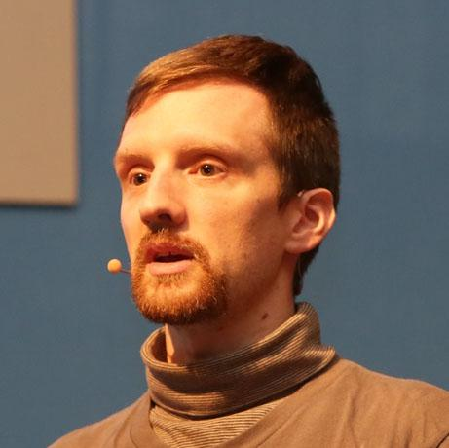
Ian Lewis
Developer Advocate - Google Cloud Platform
Tokyo, Japan
+Ian Lewis
@IanMLewis

Slide 3


Slide 4




Slide 5
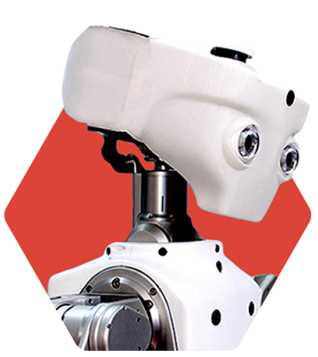
Deep Learning 101
Notes:
First I want to give some background about what Deep Learning is. Deep learning is a type of machine learning that is done with neural networks. Particularly “deep” neural networks. The term deep comes from the idea that the tree structures that make up the network have a deep structure. So they are essentially more complicated neural networks.

Slide 6

Input
Hidden
Output(label)
pixels( )
["cat"]
Notes:
Public Domain image: https://flic.kr/p/pQstAP
Neural networks are typically organized in layers. Layers are made up of a number of interconnected 'nodes' which contain an 'activation function'. Patterns are presented to the network via the 'input layer', which communicates to one or more 'hidden layers' where the actual processing is done via a system of weighted 'connections'. The hidden layers then link to an 'output layer' where the answer is output.

Slide 7
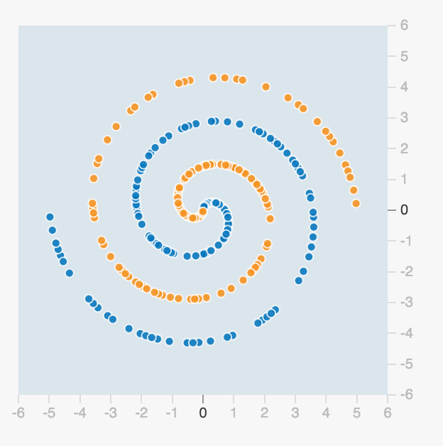
How do you classify these data points?
Neural Network
can find a way to solve the problem
Notes:
Neural networks are very good at classification and regression problems. Classification is taking an input and putting it into into predefined buckets by determining the probability it goes in each bucket. Regression is determining a mathematical style function that gives output among a range of values. Let’s take a look at what I mean.

Slide 8
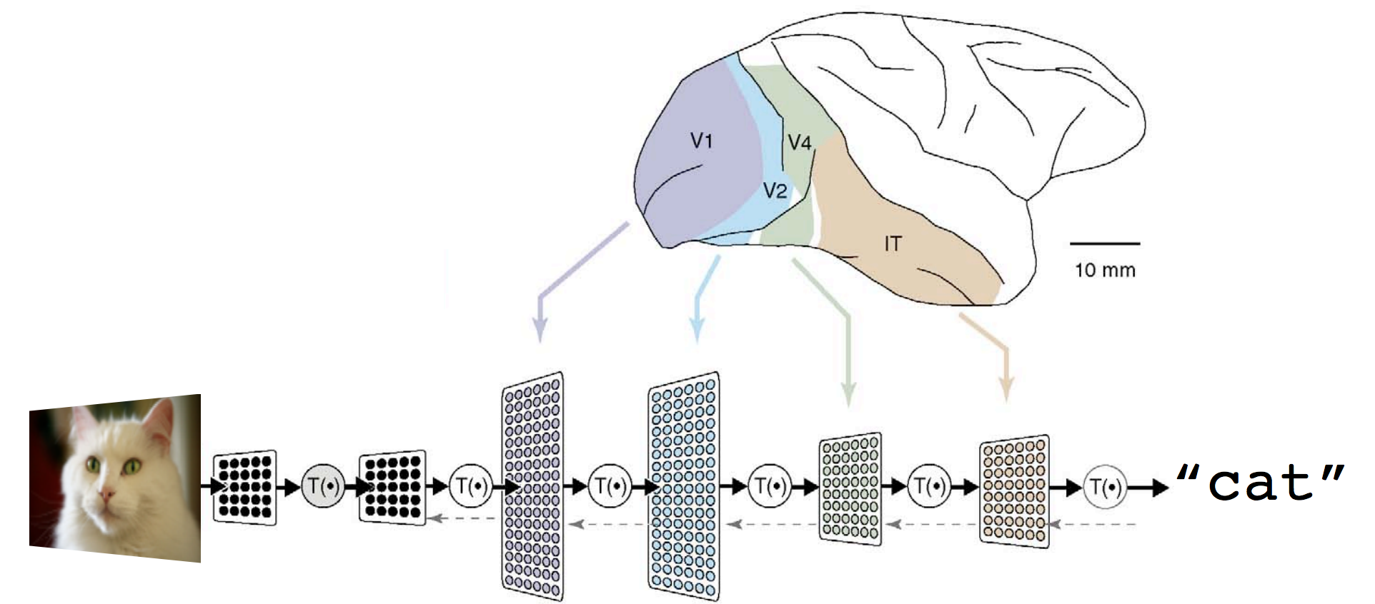
Notes:
In short, Deep Neural Network is one giant function that takes an input tensor and returns an output tensor. You put a cat image here, and you'd get a 'cat' label there.
Each layer will be trained to capture different levels of 'features', like edges, shapes, patterns and colors. Lower layers detects simple patterns and higher layer detects complex constructs.
Eventually the whole NN works as a function that recognizes images of complex objects and environments.
Each part or layer in the transformation is done via some kind mathematical operation and the data passed between layers are tensors.

Slide 9
(x,y,z,?,?,?,?,...)
Notes:
So what is a tensor? I imagine you are all familiar with x,y in 2d or x,y,z 3d coordinates. These are both examples of tensors. But tensors are even more general than that. You can imagine a point somewhere in an n-dimensional space as a tensor.

Slide 10
v[x] => vector
Notes:
Just as you can express a vector as an array.

Slide 11
m[x][y][z] => matrix
Notes:
And you can express a matrix as a 3 dimensional array.

Slide 12
t[x][y][z][?][?]... => tensor
Notes:
… a tensor is an n-dimensional array. An array that could have any number of dimensions.

Slide 13
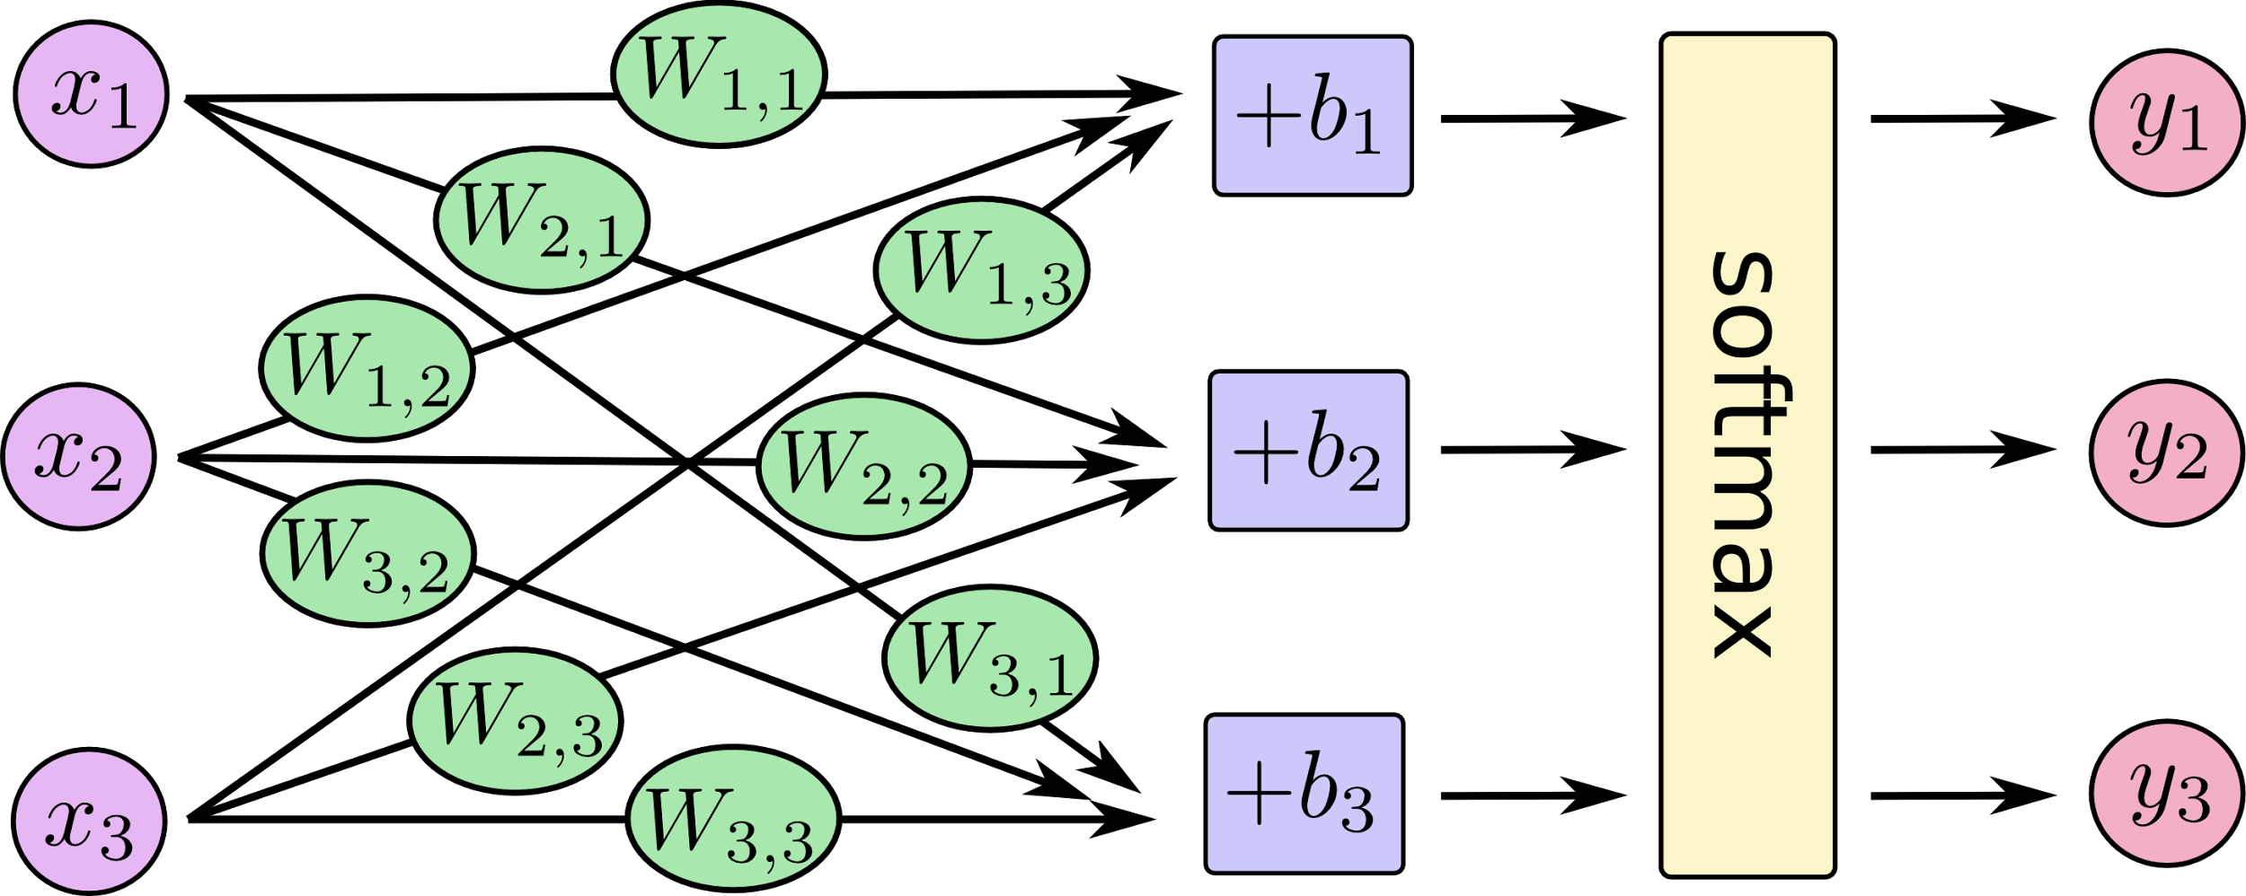
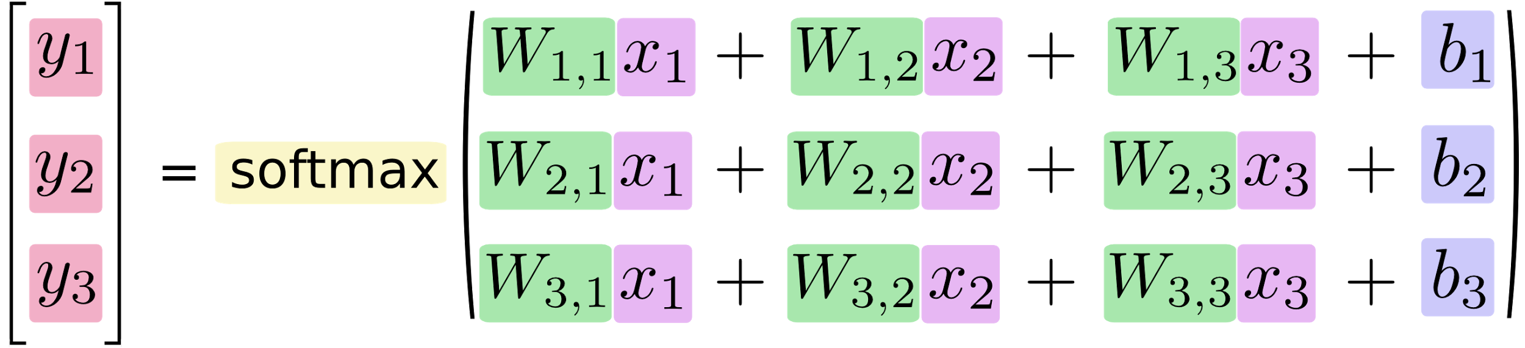
Notes:
So tensors are manipulated in the neural network by weights to create “evidence” that the image is in a particular category (cat, dog, etc.)
Let’s look at a simple example.
Most neural networks are fully connected, which means each hidden unit and each output unit is connected to every unit in the layers either side. The connections between one unit and another are represented by a number called a weight, which can be either positive (if one unit excites another) or negative (if one unit suppresses or inhibits another).
You’ll notice that in a fully connected neural network that all connections have a weight and the multiplication of the inputs by the weights can be achieved conveniently using matrix multiplication. After multiplying the weights you can then add a “bias”. Bias is simply a modifier that indicates the bias towards in the training set. For example, if you have say, more men than women in a training data set, it can help normalize results so that you don’t inherently choose more men than women.
What’s great about neural network training algorithms is that you can obtain these weights and biases automatically through training if you don’t know much about the data beforehand. But if you do, you can nudge the initial biases one way or the other based on your prior knowledge.
Typically at the end a softmax regression is run to normalize outputs.
A softmax regression has two steps: first we add up the evidence of our input being in certain classes, and then we convert that evidence into probabilities between 0 and 1.

Slide 14

Notes:
Neural networks learn things typically by a feedback process called backpropagation (sometimes abbreviated as "backprop"). This involves comparing the output a network produces with the output it was meant to produce, and using the difference between them to modify the weights of the connections between the units in the network, working from the output units through the hidden units to the input units—going backward, in other words.
Because TensorFlow knows the entire graph of your computations, it can automatically use the backpropagation algorithm to efficiently determine how your variables affect the cost you ask it to minimize. Then it can apply your choice of optimization algorithm to modify the variables and reduce the cost.
Backpropagation algorithm:
Tensorflow computes for you the partial derivatives of the loss function relatively to all weights and biases (the gradient function). At each step, you compute the value of the gradient on the current batch of data, using the current weights and biases and adjust the weights and biases by a fraction of the gradient (this fraction is called the learning rate). Then iterate with next batch of data until you are happy with the result.

Slide 15
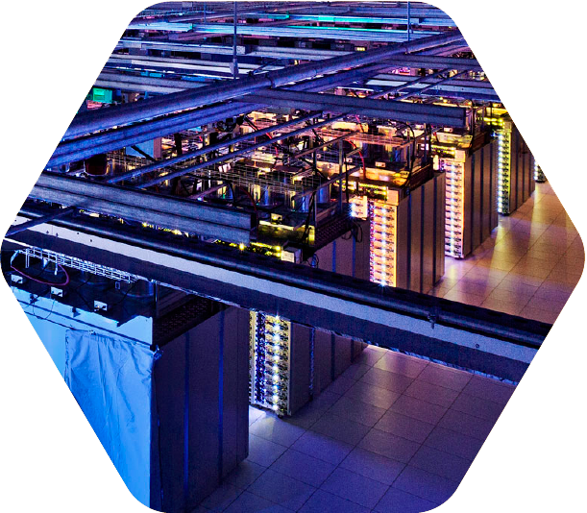
Breakthroughs
Notes:
So why is everyone talking about Deep Neural Networks all of a sudden? Well it has to do with a number of breakthroughs in speed of computers that have happened recently.

Slide 16
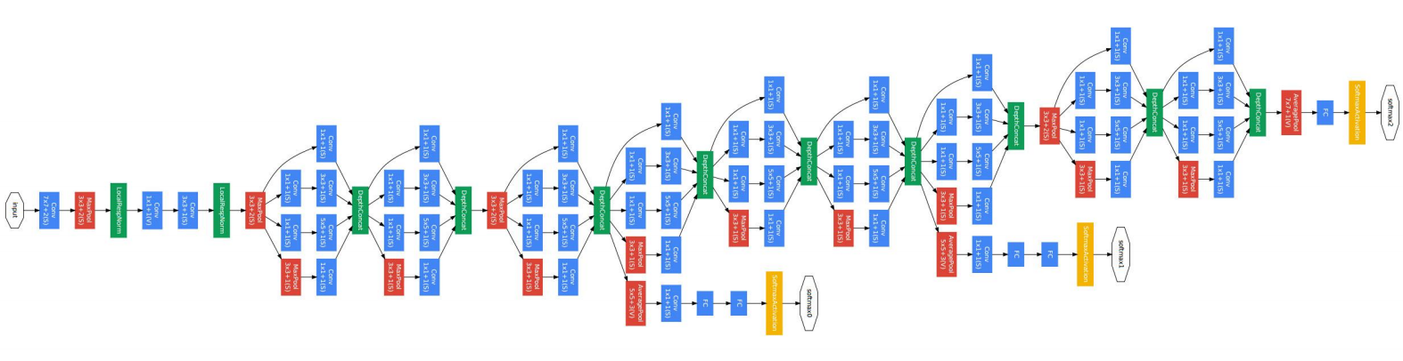
The Inception model (GoogLeNet, 2015)
Notes:
Though neural networks are pretty simple in principle, you typically need to create somewhat complex graphs in order to do anything useful. This is a visualization of the graph for our Google’s Inception model that is used as part of Google photos.
While I think these are not super complicated to parse and understand what’s going on, actually running something like this requires massive amounts of data and computation.

Slide 17
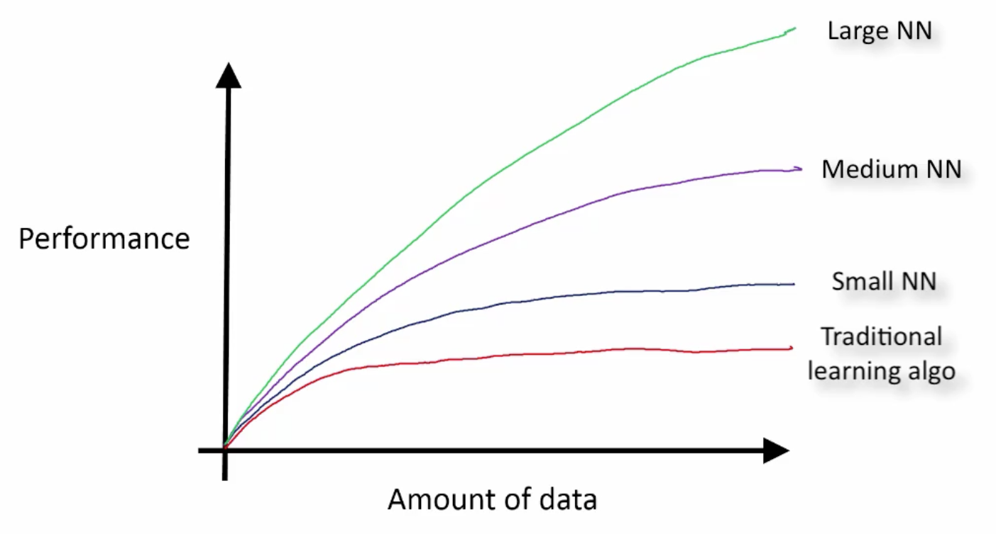
From: Andrew Ng
Notes:
The quality of the result of NN gets higher in proportional to the size of NN models and data sets.
Larger NN models and data sets, the better results you'd get. Up until recently the performance wasn’t there, so people could only use traditional learning, or small NN. And these don’t really get all that much better the more data you give it. So even if you had lots of data, you wouldn’t be able to create anything very impressive.

Slide 18
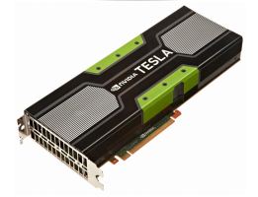
DNN = a large matrix ops
a few GPUs >> CPU
(but it still takes hours/days to train)
a supercomputer >> a few GPUs
(but you don't have a supercomputer)
You need Distributed Training
Notes:
How to train a large NN? NN is all about matrix operations. A GPU typically performs these kinds of operations tens of times faster than a CPU.
In these kind of neural networks you could distribute the computations but it’s very complicated, and you would need to send massive amounts of data between computers over the network. The network then becomes a bottleneck and doesn’t scale beyond a few machines.
You might say let’s use supercomputers! They have fast hardware interconnects between CPUs! In fact, some serious DNN researchers have started using supercomputers for NN training. But supercomputers are ridiculously expensive. You either need to buy one are lease time on one for a hefty price. Ask your boss if he wants to foot the bill!
So only a few people can use supercomputers. Almost all DNN developers are using single GPU server (with multiple GPUs if you are lucky), waiting for days and weeks before finishing the training.
Does this work in production? No. We definitely need a Distributed Training environment with hundreds of GPUs on fast network.

Slide 19

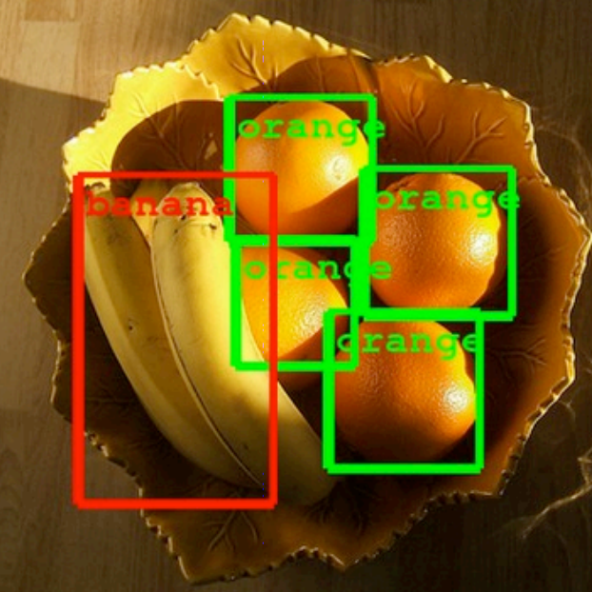
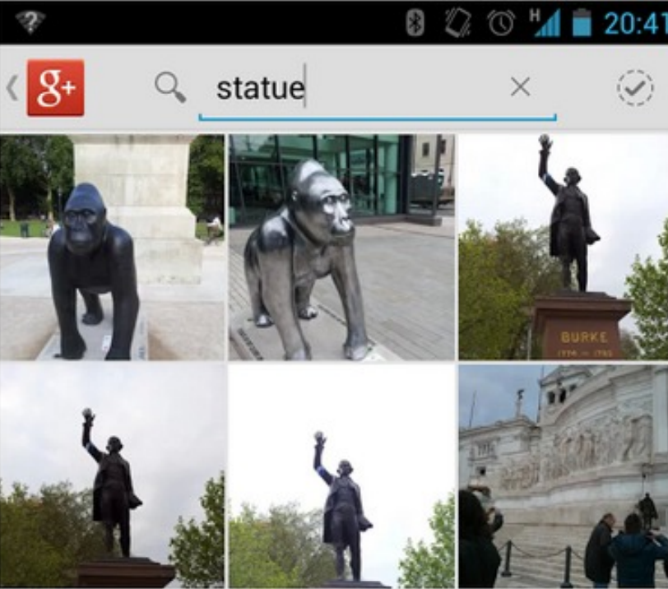
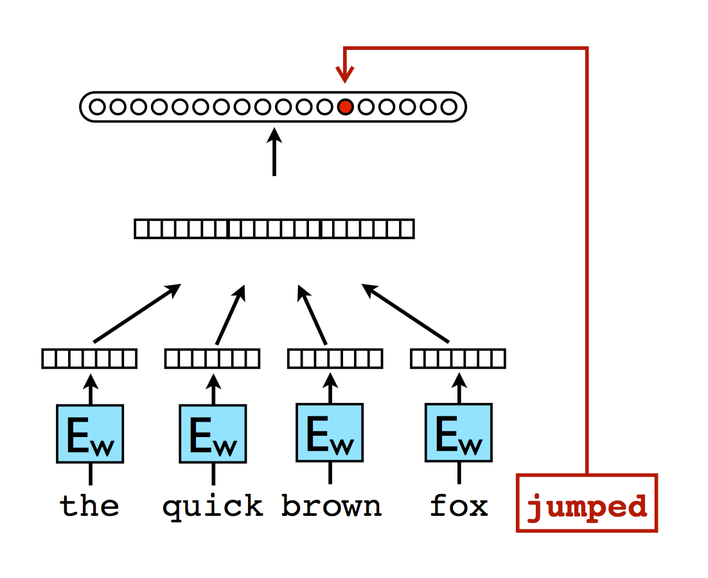
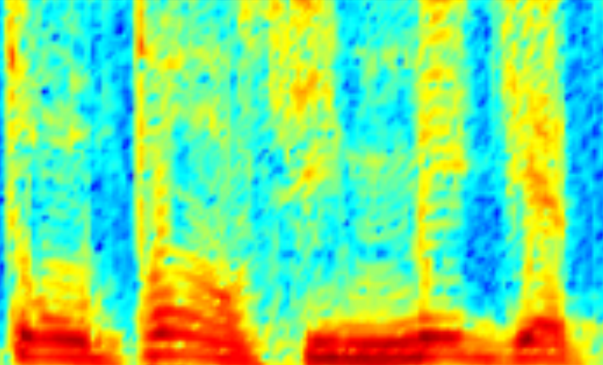
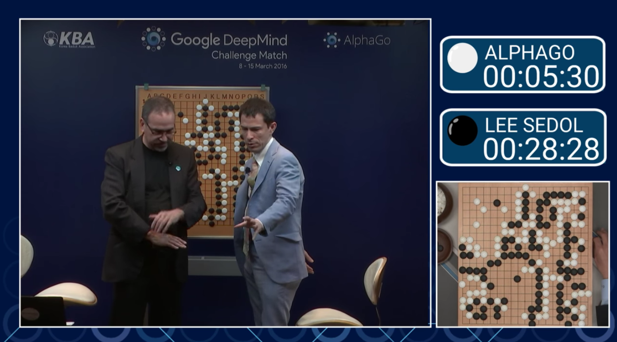
Notes:
For example, the ranking on Google Search, the voice recognition in Android, image classification in Google Photos, OCR, NLP and so on.
They all have been using the deep learning technologies for years.

Slide 20
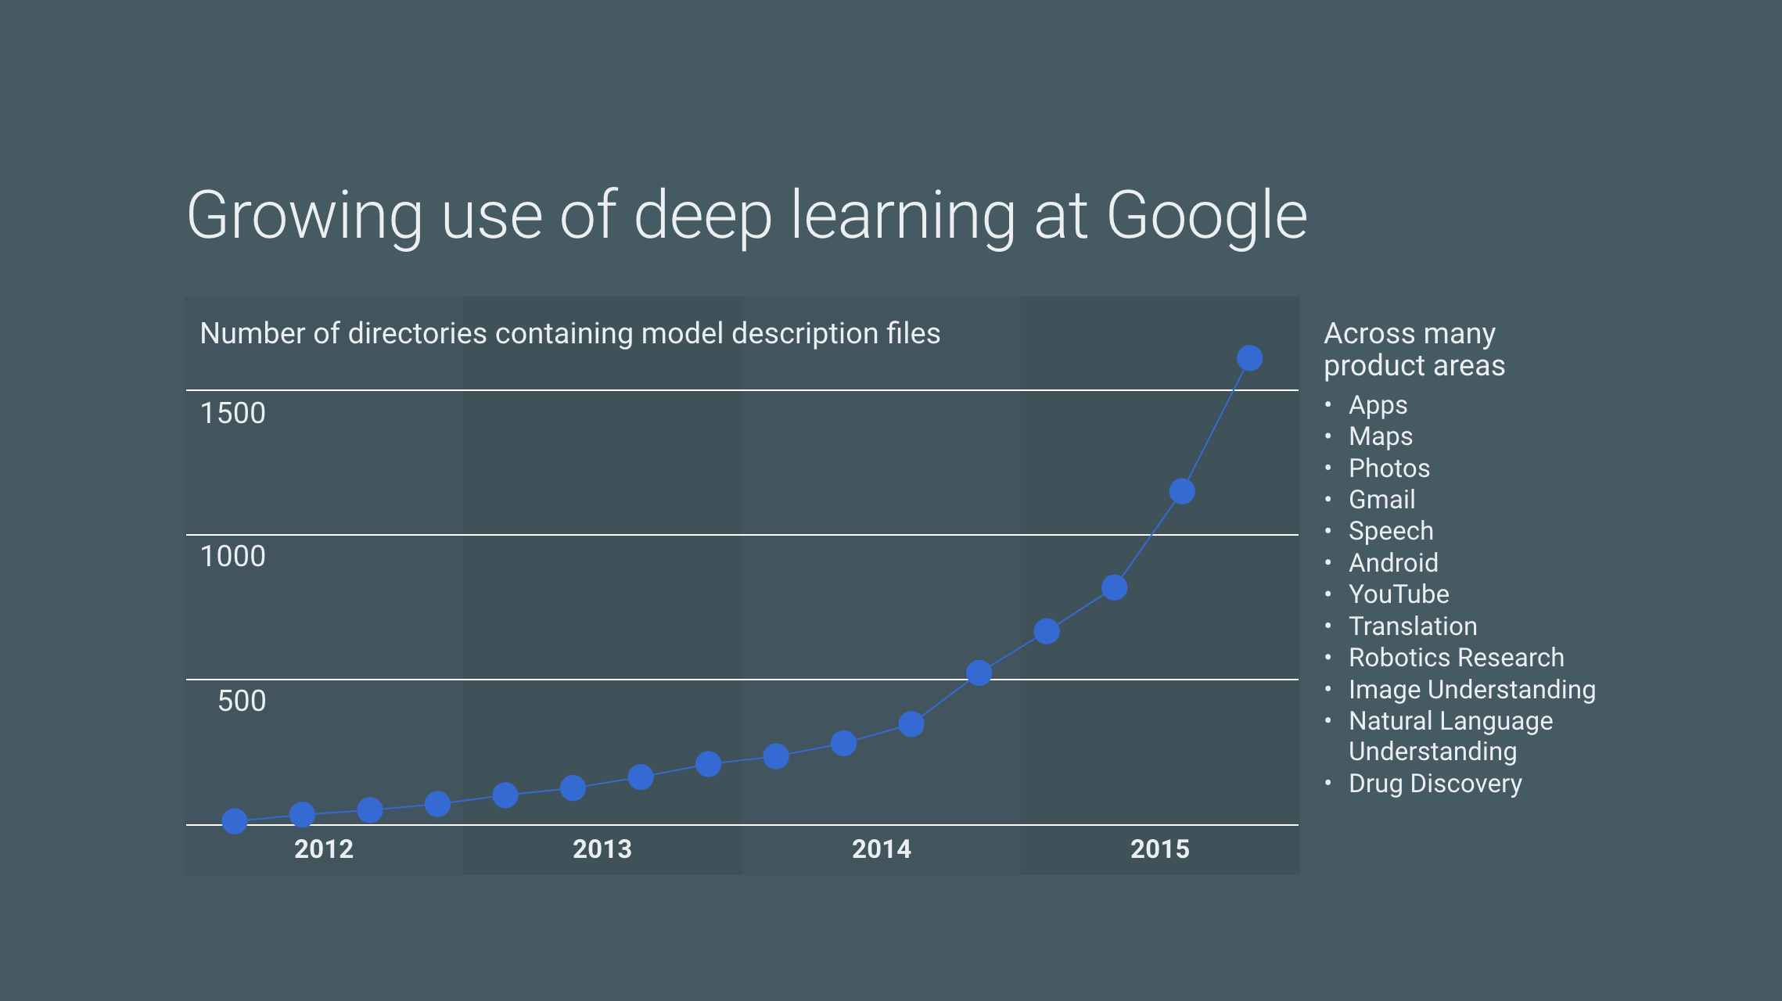
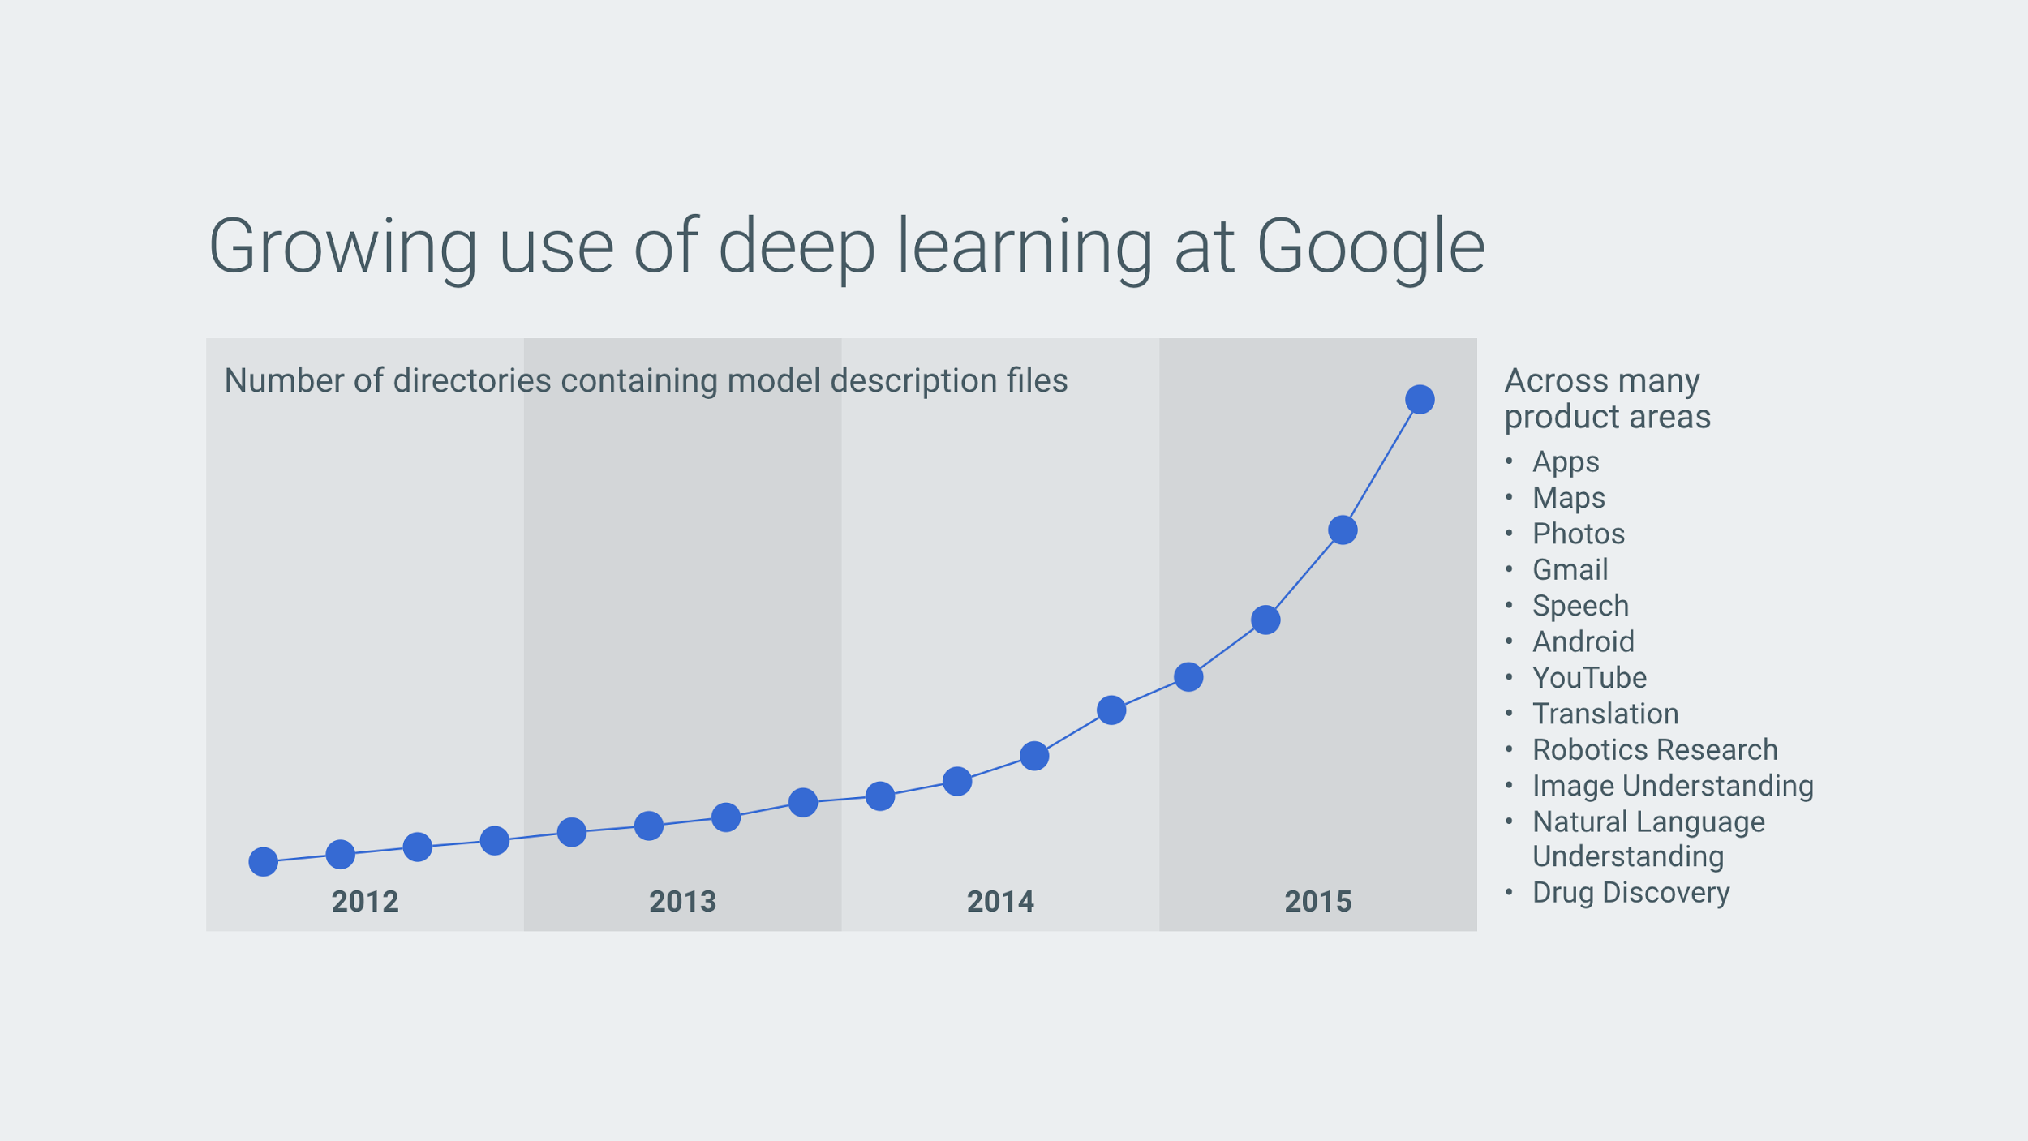
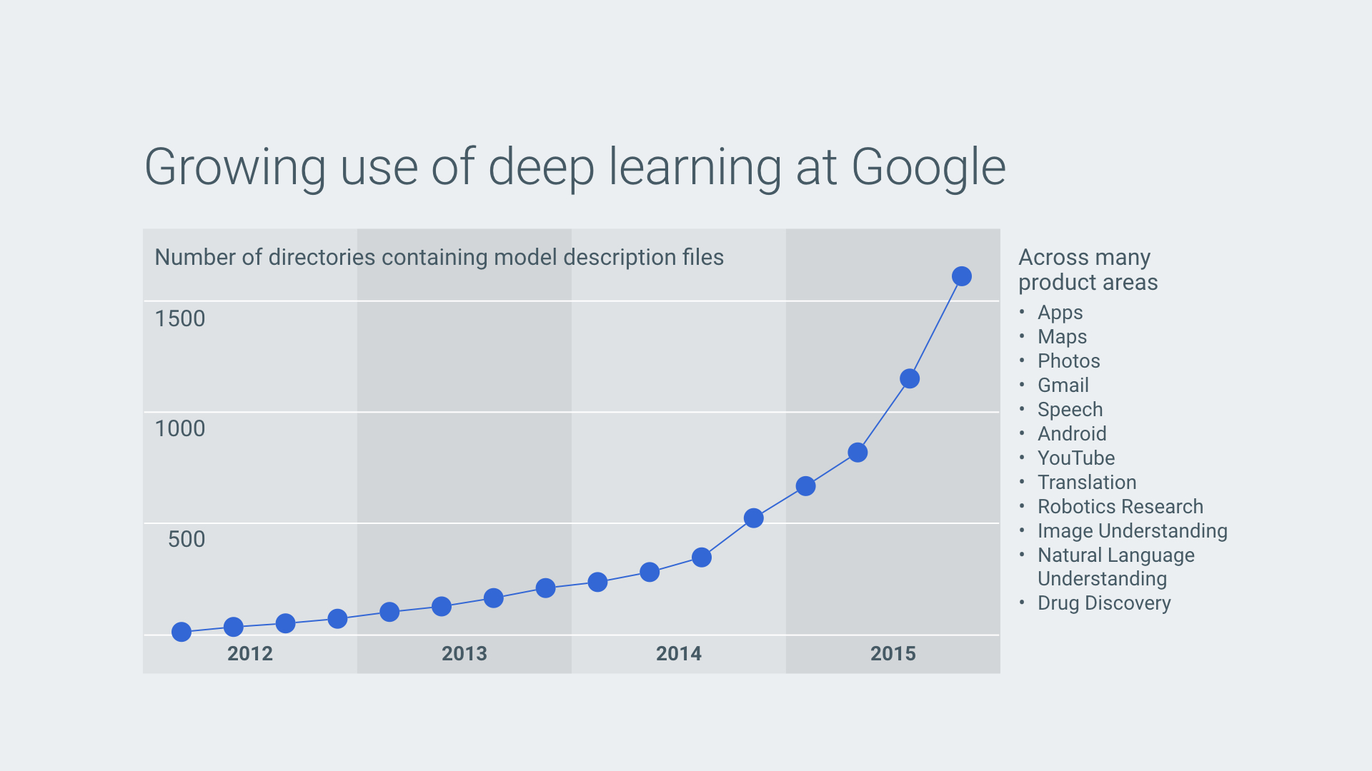
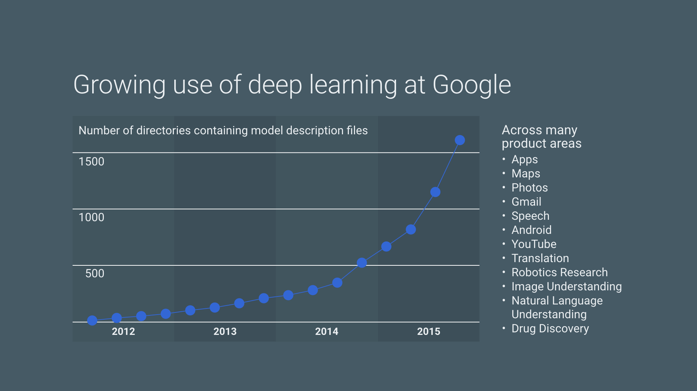
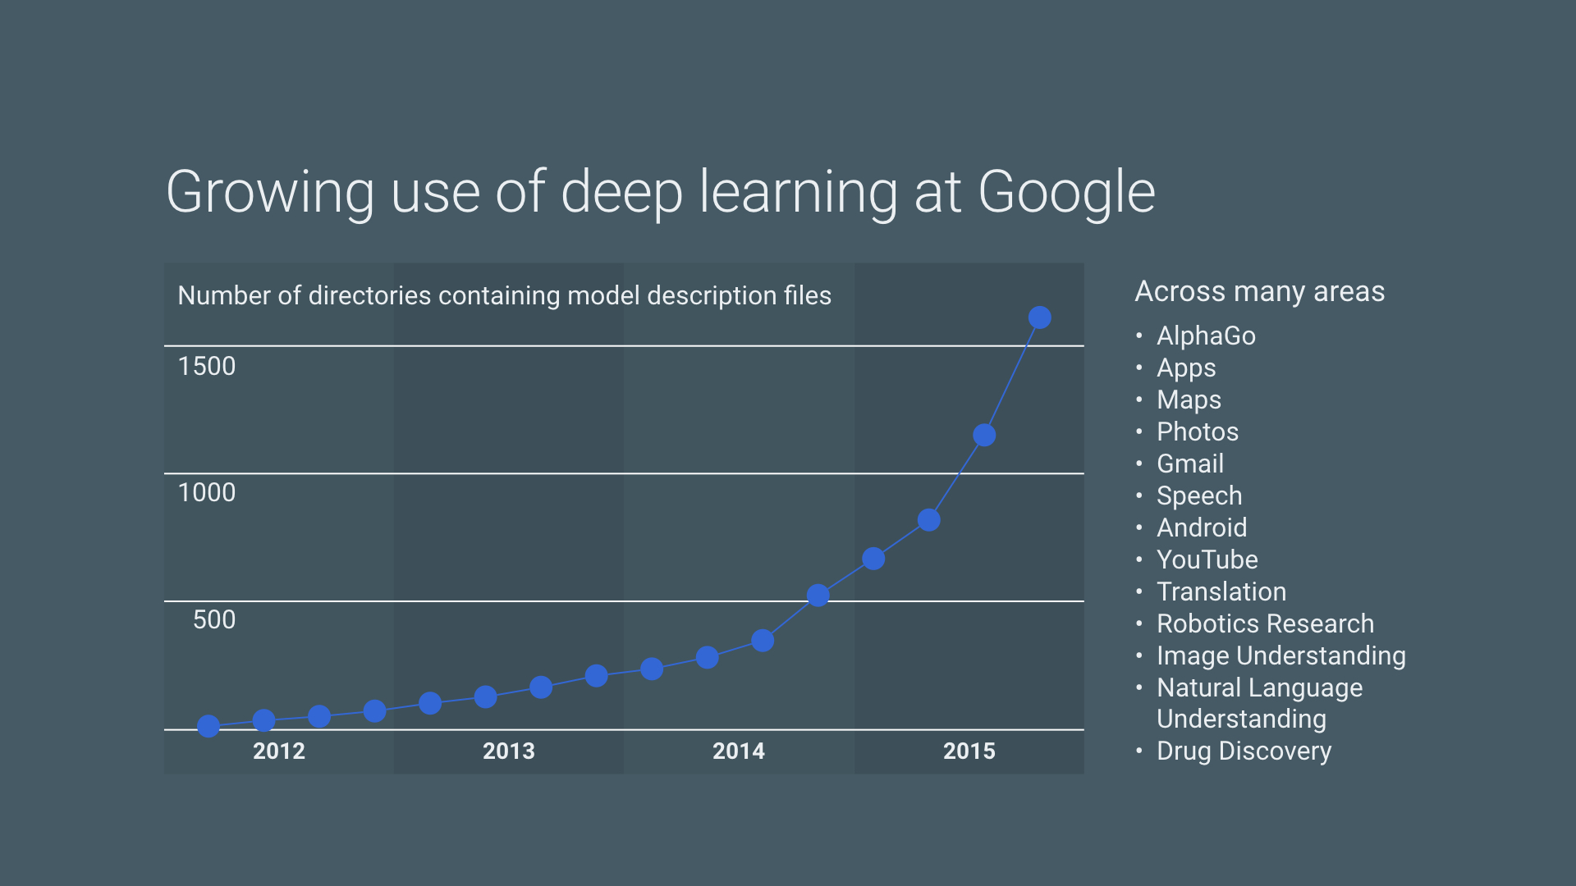
Notes:
Now we have over 20 production projects that has been using deep learning technology.
At Google, DNN is not just an academic research anymore. It's a reliable and scalable production technology.

Slide 21
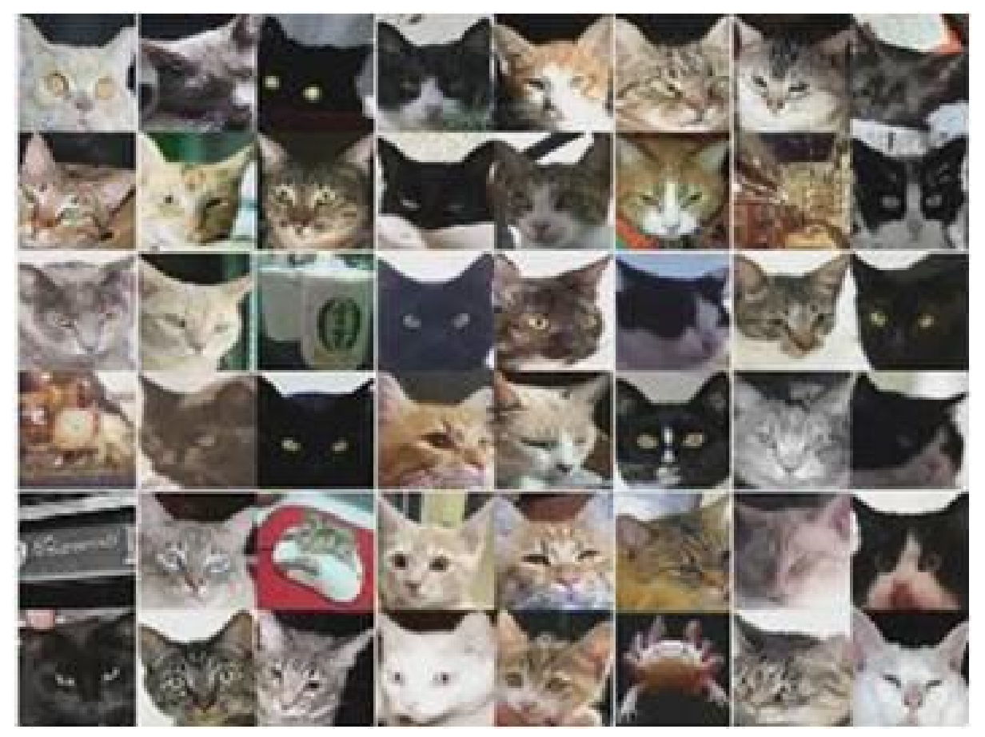
What's the scalability of Google Brain?
"Large Scale Distributed Systems for Training Neural Networks", NIPS 2015
Inception / ImageNet: 40x with 50 GPUs
RankBrain: 300x with 500 nodes
Notes:
For example, RankBrain uses 500 nodes to gain 300x higher performance for Google Search ranking algorithm.
Image analysis with Inception model can be 40x faster with 50 GPU nodes.

Slide 22

TensorFlow
Notes:
So we created TensorFlow as a library to build deep neural networks at Google.

Slide 23

What is Tensorflow?
Google's open source library for machine intelligence
tensorflow.org launched in Nov 2015
The second generation
Used by many production ML projects

Slide 24
TensorFlow
Operates over tensors: n-dimensional arrays
Using a flow graph: data flow computation framework
Flexible, intuitive construction
automatic differentiation
Support for threads, queues, and asynchronous computation; distributed runtime
Train on CPUs, GPUs
Run wherever you like
Notes:
Opensourced late last year.
Data flow graphs describe mathematical computation with a directed graph of nodes & edges. Nodes typically implement mathematical operations, but can also represent endpoints to feed in data, push out results, or read/write persistent variables. Edges describe the input/output relationships between nodes. These data edges carry dynamically-sized multidimensional data arrays, or tensors. The flow of tensors through the graph is where TensorFlow gets its name.
Flexible, auto-differentiation, custom ops, …
As a TensorFlow user, you define the computational architecture of your predictive model, combine that with your objective function, and just add data -- TensorFlow handles computing the derivatives for you. Computing the derivative of some values w.r.t. other values in the model just extends your graph, so you can always see exactly what's going on.

Slide 25
Core TensorFlow data structures and concepts...
Graph: A TensorFlow computation, represented as a dataflow graph.
collection of ops that may be executed together as a group
Operation: a graph node that performs computation on tensors
Tensor: a handle to one of the outputs of an Operation
provides a means of computing the value in a TensorFlow Session.
Notes:
TensorFlow lets us describe a graph of interacting operations that run entirely outside Python. (Approaches like this can be seen in a few machine learning libraries.)

Slide 26
Core TensorFlow data structures and concepts
Constants
Placeholders: must be fed with data on execution
Variables: a modifiable tensor that lives in TensorFlow's graph of interacting operations.
Session: encapsulates the environment in which Operation objects are executed, and Tensor objects are evaluated.
Notes:
Tensorflow also provides data structures that define placeholders (input values to a graph), variables (values that can be modified during training), and the Session which is the core TensorFlow environment for the operations to be executed.

Slide 27
Operations
Category
Element-wise math ops
Array ops
Matrix ops
Stateful ops
NN building blocks
Checkpointing ops
Queue & synch ops
Control flow ops
Examples
Add, Sub, Mul, Div, Exp, Log, Greater, Less…
Concat, Slice, Split, Constant, Rank, Shape…
MatMul, MatrixInverse, MatrixDeterminant…
Variable, Assign, AssignAdd...
SoftMax, Sigmoid, ReLU, Convolution2D…
Save, Restore
Enqueue, Dequeue, MutexAcquire…
Merge, Switch, Enter, Leave...
Notes:
Here’s a non-exhaustive list of the operations that TensorFlow has built in.

Slide 28

Notes:
So let’s take a look at an example of using TensorFlow

Slide 29
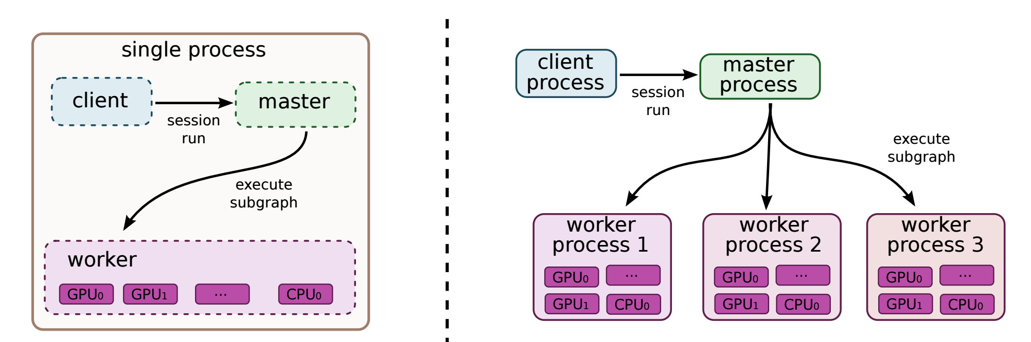
Distributed Training with TensorFlow
Notes:
So as you can see TensorFlow is similar to other libraries. The main difference between TensorFlow and other libraries like Theano is the ability to distribute the workload.

Slide 30
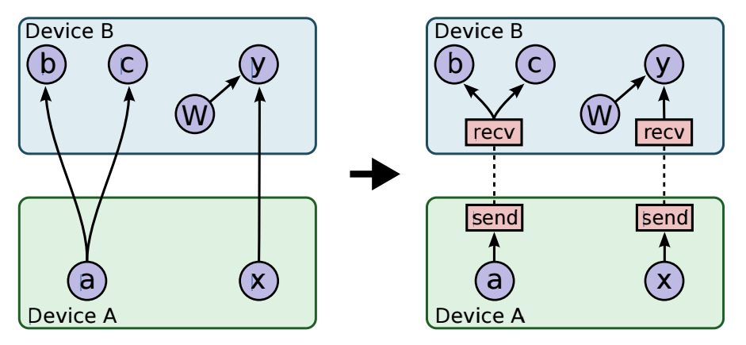
Distributed Training with TensorFlow
CPU/GPU scheduling
Communications
Local, RPC, RDMA
32/16/8 bit quantization
Cost-based optimization
Fault tolerance
Notes:
Tensorflow can acheive distributed training by breaking up the graph operations and mapping to different execution devices, like a CPU or GPU.

Slide 31
Distributed Training
Model Parallelism
Sub-Graph | Allows fine grained application of parallelism to slow graph components Larger more complex graph
Full Graph | Code is more similar to single process models Not necessarily as performant (large models)
Data Parallelism
Synchronous | Prevents workers from “Falling behind” Workers progress at the speed of the slowest worker
Asynchronous | Workers advance as fast as they can Can result in runs that aren’t reproducible or difficult to debug behavior (large models)
Notes:
At a high level there are two large choices you need to make when defining a distributed TensorFlow model, these choices can affect everything from developer workflow, to model performance, and need to take into account the size and structure of the underlying algorithm.

Slide 32

Cloud Machine Learning (Cloud ML)
Fully managed, distributed training and prediction for custom TensorFlow graph
Supports Regression and Classification initially
Integrated with Cloud Dataflow and Cloud Datalab
Limited Preview - cloud.google.com/ml

Slide 33
Cloud ML
Jeff Dean's keynote: YouTube video
Define a custom TensorFlow graph
Training at local: 8.3 hours w/ 1 node
Training at cloud: 32 min w/ 20 nodes (15x faster)
Prediction at cloud at 300 reqs / sec
Notes:
Cloud ML Demo by Jeff Dean at GCP Next 2016:
https://youtu.be/HgWHeT_OwHc?t=2h9m37s

Slide 34
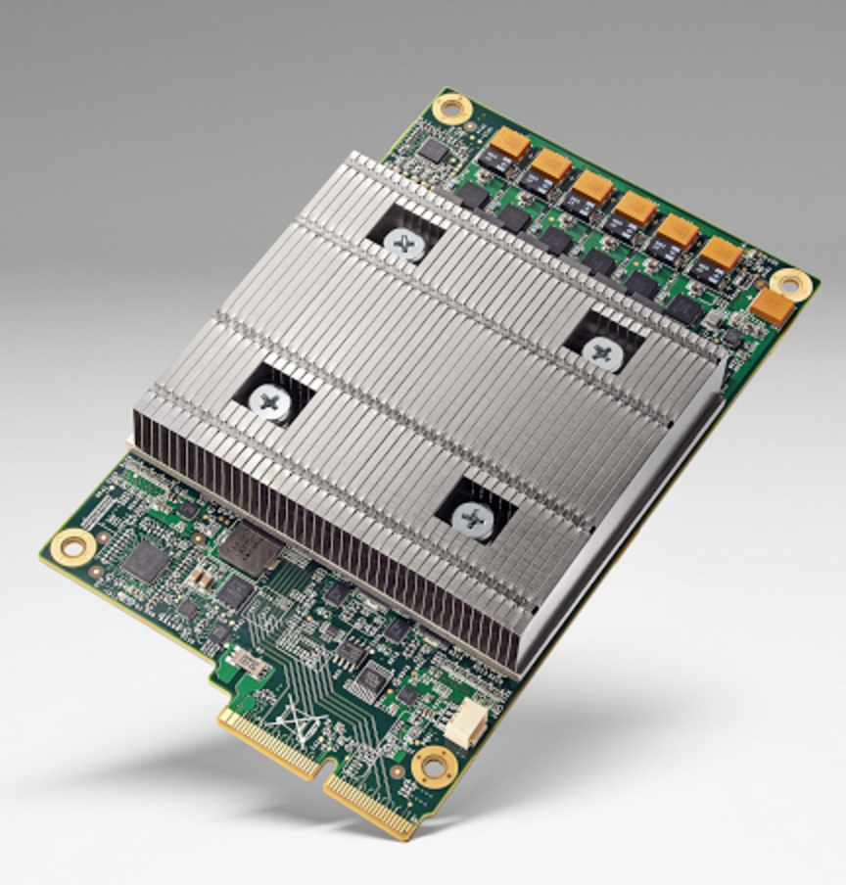
Tensor Processing Unit
ASIC for TensorFlow
Designed by Google
10x better perf / watt
8 bit quantization

Slide 35

Thank You
https://www.tensorflow.org/
https://cloud.google.com/ml/
http://bit.ly/tensorflow-workshop
Ian Lewis @IanMLewis

